Slide 1

BOOSTING ALGORITHM
XG BOOSTING /
Gradient Boosting
Notes:
XGBoost is a boosting algorithm that uses bagging, which trains multiple decision trees and then combines the results. It allows XGBoost to learn more quickly than other algorithms but also gives it an advantage in situations with many features to consider.

Slide 2
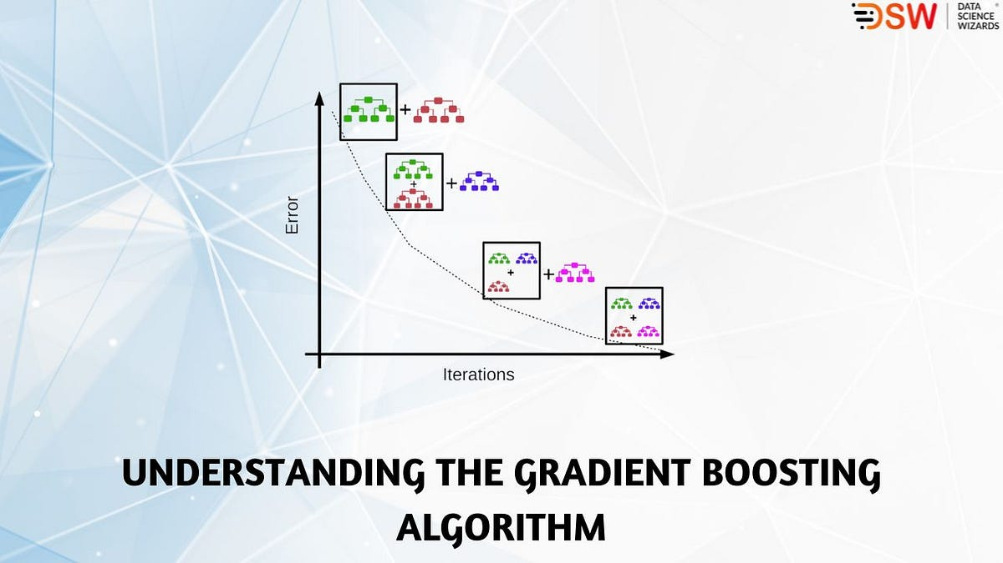
PRINCIPLE OF XG BOOSTING
Notes:
Gradient Boosting is a powerful boosting algorithm that combines several weak learners into strong learners, in which each new model is trained to minimize the loss function such as mean squared error or cross-entropy of the previous model using gradient descent.

Slide 3
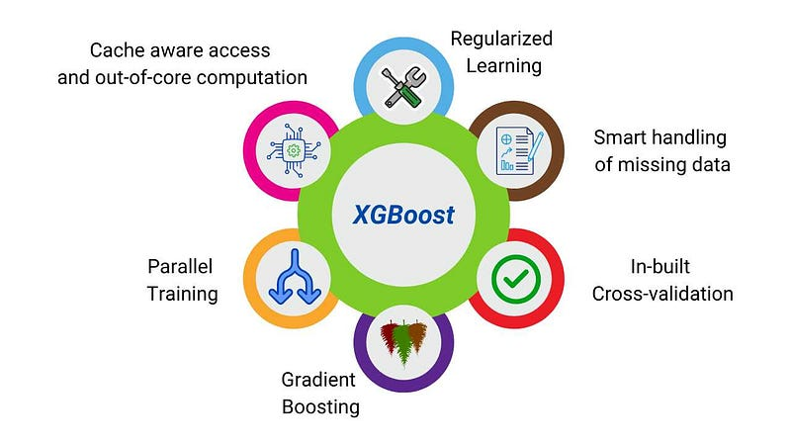
APPLICATION OF XG BOOSTING
Notes:
Usage on a wide range of applications, including solving problems in regression, classification, ranking, and user-defined prediction challenges.

Slide 4

USES OF XGBOOSTING
Notes:
Overall, XGBoost is a powerful and widely-used tool for regression tasks, and it has been applied successfully to a variety of real-world problems such as predictive modeling, time series forecasting, and customer churn prediction. Advantages: Effective with large data sets.

Slide 5

CONCLUSION OF XG BOOSTING
Notes:
When you use XGBoost, there are no restrictions on the size of your dataset, so you can work with datasets that are larger than what would be possible with other algorithms. Model performance is also essential because it allows you to create models that can perform better than other models.

Slide 6

ADVANTAGES AND DISADVANTAGES OF XG BOOSTING
Notes:
Advantages: The advantages of gradient boosting include its ability to handle complex data and its high predictive accuracy.
Disadvantages: However, it can be computationally expensive and prone to overfitting.

